Slide 1
Chain Rule

Slide 2

Chain Rule
If $h\left(x\right)=f$∘$g(x)$, then ${h^{′}\left(x\right)=f}^{′}\left(g\left(x\right)\right)g′(x)$
$\frac{dy}{dx}=\frac{dy}{du}∙\frac{du}{dx}$
Newton notation
Leibniz notation

Slide 3
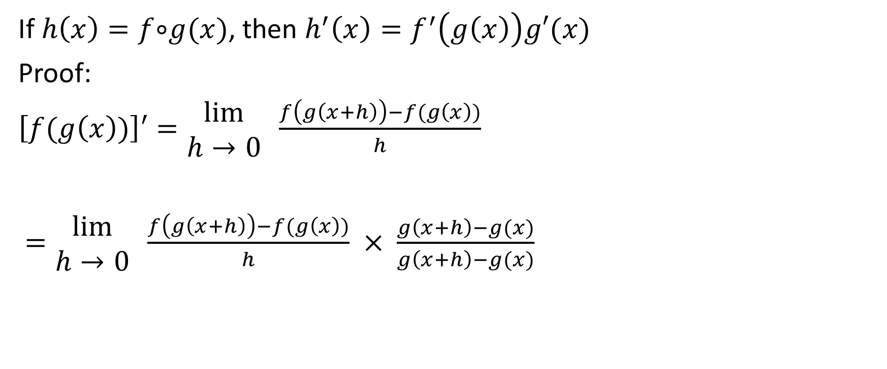
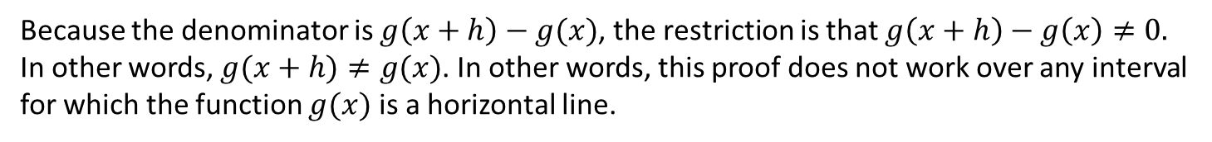
Proof
If $h\left(x\right)=f$∘$g(x)$, then ${h^{′}\left(x\right)=f}^{′}\left(g\left(x\right)\right)g′(x)$
Proof:
$\left[f(g\left(x\right))\right]′=\begin{matrix}lim⁡ \\ h→0\end{matrix} \frac{f\left(g\left(x+h\right)\right)−f(g\left(x\right))}{h}$
$=\begin{matrix}lim⁡ \\ h→0\end{matrix} \frac{f\left(g\left(x+h\right)\right)−f(g\left(x\right))}{h} × \frac{g\left(x+h\right)−g(x)}{g\left(x+h\right)−g(x)}$
Multiply by $\frac{g\left(x+h\right)−g(x)}{g\left(x+h\right)−g(x)}$ (in other words, we will multiply by 1)
Because the denominator is $g\left(x+h\right)−g(x)$, the restriction is that $g\left(x+h\right)−g\left(x\right)≠0.$ In other words, $g(x+h)≠g(x)$. In other words, this proof does not work over any interval for which the function $g(x)$ is a horizontal line.

Slide 4
If $h\left(x\right)=f$∘$g(x)$, then ${h^{′}\left(x\right)=f}^{′}\left(g\left(x\right)\right)g′(x)$
Proof:
$\left[f(g\left(x\right))\right]′=\begin{matrix}lim⁡ \\ h→0\end{matrix} \frac{f\left(g\left(x+h\right)\right)−f(g\left(x\right))}{h}$
$=\begin{matrix}lim⁡ \\ h→0\end{matrix} \frac{f\left(g\left(x+h\right)\right)−f(g\left(x\right))}{h} × \frac{g\left(x+h\right)−g(x)}{g\left(x+h\right)−g(x)}$
Multiply by $\frac{g\left(x+h\right)−g(x)}{g\left(x+h\right)−g(x)}$ (in other words, we will multiply by 1)
Switch the order of the denominators. We can do this because we are multiplying anyways.

Slide 5
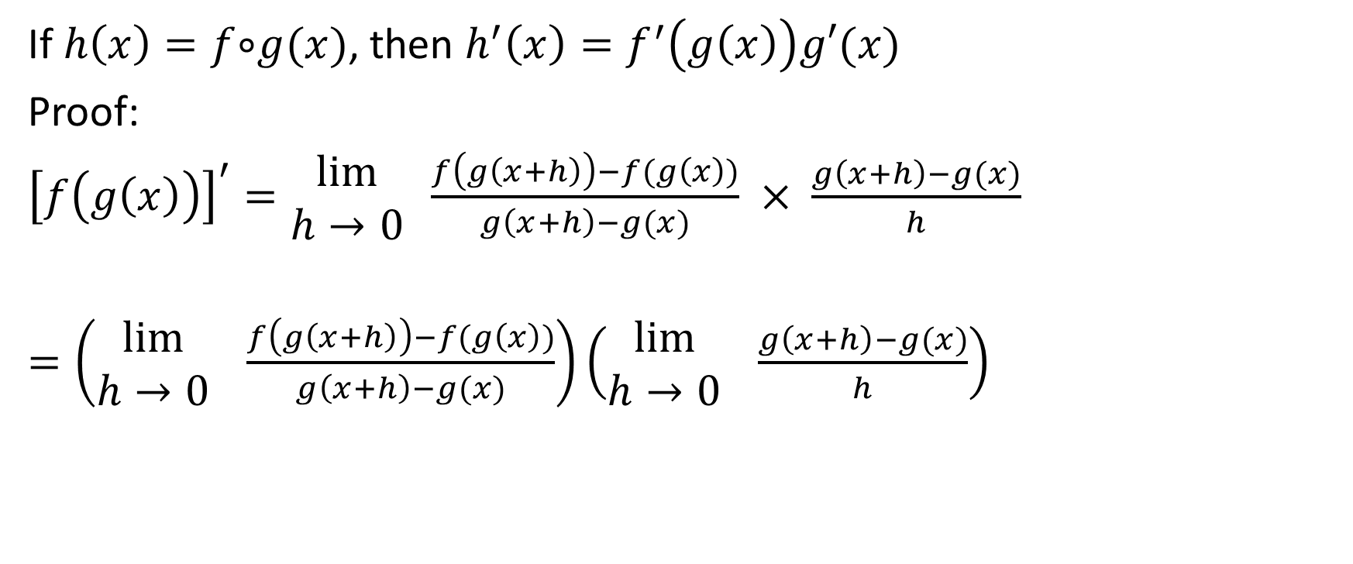
If $h\left(x\right)=f$∘$g(x)$, then ${h^{′}\left(x\right)=f}^{′}\left(g\left(x\right)\right)g′(x)$
Proof:
${\left[f\left(g\left(x\right)\right)\right]}^{′}=\begin{matrix}lim⁡ \\ h→0\end{matrix} \frac{f\left(g\left(x+h\right)\right)−f(g\left(x\right))}{g\left(x+h\right)−g(x)} × \frac{g\left(x+h\right)−g(x)}{h}$
$=\left(\begin{matrix}lim⁡ \\ h→0\end{matrix} \frac{f\left(g\left(x+h\right)\right)−f(g\left(x\right))}{g\left(x+h\right)−g(x)}\right)\left(\begin{matrix}lim⁡ \\ h→0\end{matrix} \frac{g\left(x+h\right)−g(x)}{h}\right)$
Now, we can distribute the limit notation

Slide 6

If $h\left(x\right)=f$∘$g(x)$, then ${h^{′}\left(x\right)=f}^{′}\left(g\left(x\right)\right)g′(x)$
Proof:
$=\left(\begin{matrix}lim⁡ \\ h→0\end{matrix} \frac{f\left(g\left(x+h\right)\right)−f(g\left(x\right))}{g\left(x+h\right)−g(x)}\right)\left(\begin{matrix}lim⁡ \\ h→0\end{matrix} \frac{g\left(x+h\right)−g(x)}{h}\right)$
Here’s the most interesting part

Slide 7
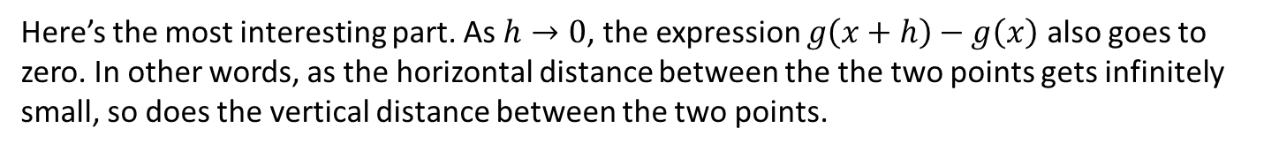

If $h\left(x\right)=f$∘$g(x)$, then ${h^{′}\left(x\right)=f}^{′}\left(g\left(x\right)\right)g′(x)$
Proof:
$=\left(\begin{matrix}lim⁡ \\ h→0\end{matrix} \frac{f\left(g\left(x+h\right)\right)−f(g\left(x\right))}{g\left(x+h\right)−g(x)}\right)\left(\begin{matrix}lim⁡ \\ h→0\end{matrix} \frac{g\left(x+h\right)−g(x)}{h}\right)$
Here’s the most interesting part. As $h→0$, the expression $g\left(x+h\right)−g\left(x\right)$ also goes to zero. In other words, as the horizontal distance between the the two points gets infinitely small, so does the vertical distance between the two points.

Slide 8
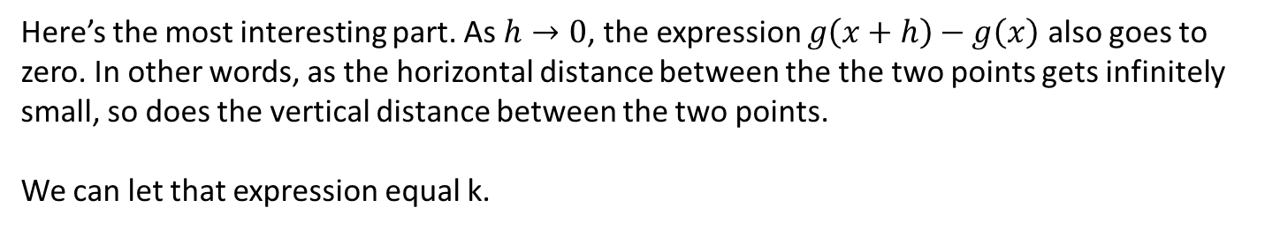

If $h\left(x\right)=f$∘$g(x)$, then ${h^{′}\left(x\right)=f}^{′}\left(g\left(x\right)\right)g′(x)$
Proof:
$=\left(\begin{matrix}lim⁡ \\ h→0\end{matrix} \frac{f\left(g\left(x+h\right)\right)−f(g\left(x\right))}{k}\right)\left(\begin{matrix}lim⁡ \\ h→0\end{matrix} \frac{g\left(x+h\right)−g(x)}{h}\right)$
Here’s the most interesting part. As $h→0$, the expression $g\left(x+h\right)−g\left(x\right)$ also goes to zero. In other words, as the horizontal distance between the the two points gets infinitely small, so does the vertical distance between the two points.
We can let that expression equal k.

Slide 9
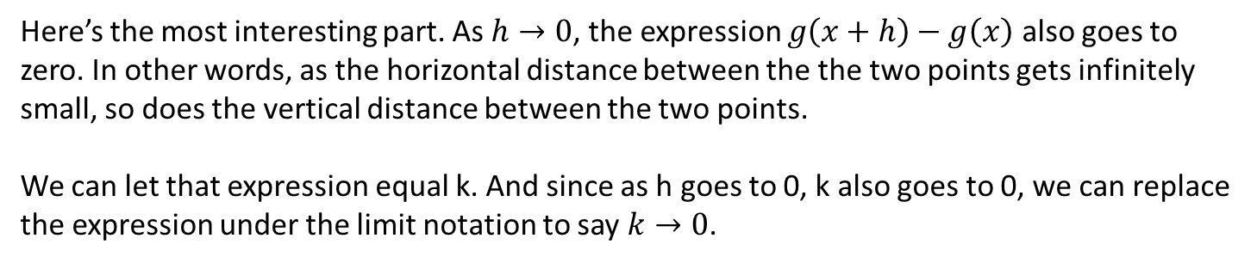

If $h\left(x\right)=f$∘$g(x)$, then ${h^{′}\left(x\right)=f}^{′}\left(g\left(x\right)\right)g′(x)$
Proof:
$=\left(\begin{matrix}lim⁡ \\ k→0\end{matrix} \frac{f\left(g\left(x+k\right)\right)−f(g\left(x\right))}{k}\right)\left(\begin{matrix}lim⁡ \\ h→0\end{matrix} \frac{g\left(x+h\right)−g(x)}{h}\right)$
Here’s the most interesting part. As $h→0$, the expression $g\left(x+h\right)−g\left(x\right)$ also goes to zero. In other words, as the horizontal distance between the the two points gets infinitely small, so does the vertical distance between the two points.
We can let that expression equal k. And since as h goes to 0, k also goes to 0, we can replace the expression under the limit notation to say $k→0$.

Slide 10



If $h\left(x\right)=f$∘$g(x)$, then ${h^{′}\left(x\right)=f}^{′}\left(g\left(x\right)\right)g′(x)$
Proof:
$=\left(\begin{matrix}lim⁡ \\ k→0\end{matrix} \frac{f\left(g\left(x+k\right)\right)−f(g\left(x\right))}{k}\right)\left(\begin{matrix}lim⁡ \\ h→0\end{matrix} \frac{g\left(x+h\right)−g(x)}{h}\right)$
$f′(g\left(x\right))$

Slide 11



If $h\left(x\right)=f$∘$g(x)$, then ${h^{′}\left(x\right)=f}^{′}\left(g\left(x\right)\right)g′(x)$
Proof:
$=\left(\begin{matrix}lim⁡ \\ k→0\end{matrix} \frac{f\left(g\left(x+k\right)\right)−f(g\left(x\right))}{k}\right)\left(\begin{matrix}lim⁡ \\ h→0\end{matrix} \frac{g\left(x+h\right)−g(x)}{h}\right)$
$=f^{′}\left(g\left(x\right)\right)g′(x)$
$g′(x)$

Slide 12

If $h\left(x\right)=f$∘$g(x)$, then ${h^{′}\left(x\right)=f}^{′}\left(g\left(x\right)\right)g′(x)$
Proof:
$=\left(\begin{matrix}lim⁡ \\ k→0\end{matrix} \frac{f\left(g\left(x+k\right)\right)−f(g\left(x\right))}{k}\right)\left(\begin{matrix}lim⁡ \\ h→0\end{matrix} \frac{g\left(x+h\right)−g(x)}{h}\right)$
$=f^{′}\left(g\left(x\right)\right)g′(x)$

Slide 13
Let’s see how this works in the case of a “power of a function”

Slide 14

Example
Determine the derivative of $h\left(x\right)={\left(10x^{3}−7x^{2}+3x−9\right)}^{14}$

Slide 15
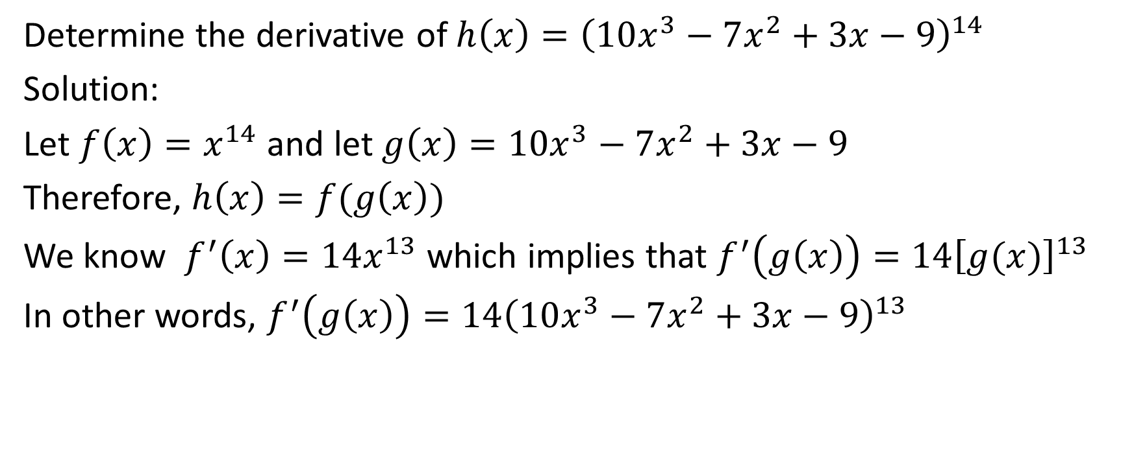
Determine the derivative of $h\left(x\right)={\left(10x^{3}−7x^{2}+3x−9\right)}^{14}$
Solution:
Let $f\left(x\right)=x^{14}$ and let $g\left(x\right)=10x^{3}−7x^{2}+3x−9$
Therefore, $h\left(x\right)=f(g\left(x\right))$
We know $f^{′}\left(x\right)=14x^{13}$ which implies that $f^{′}\left(g\left(x\right)\right)=14{\left[g(x)\right]}^{13}$
In other words, $f^{′}\left(g\left(x\right)\right)=14{\left(10x^{3}−7x^{2}+3x−9\right)}^{13}$

Slide 16
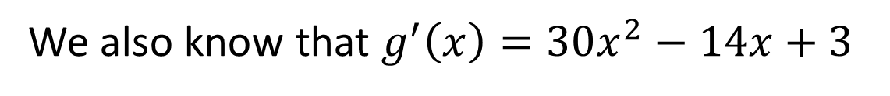
Determine the derivative of $h\left(x\right)={\left(10x^{3}−7x^{2}+3x−9\right)}^{14}$
Solution:
Let $f\left(x\right)=x^{14}$ and let $g\left(x\right)=10x^{3}−7x^{2}+3x−9$
Therefore, $h\left(x\right)=f(g\left(x\right))$
We know $f^{′}\left(x\right)=14x^{13}$ which implies that $f^{′}\left(g\left(x\right)\right)=14{\left[g(x)\right]}^{13}$
In other words, $f^{′}\left(g\left(x\right)\right)=14{\left(10x^{3}−7x^{2}+3x−9\right)}^{13}$
We also know that $g^{′}\left(x\right)=30x^{2}−14x+3$

Slide 17
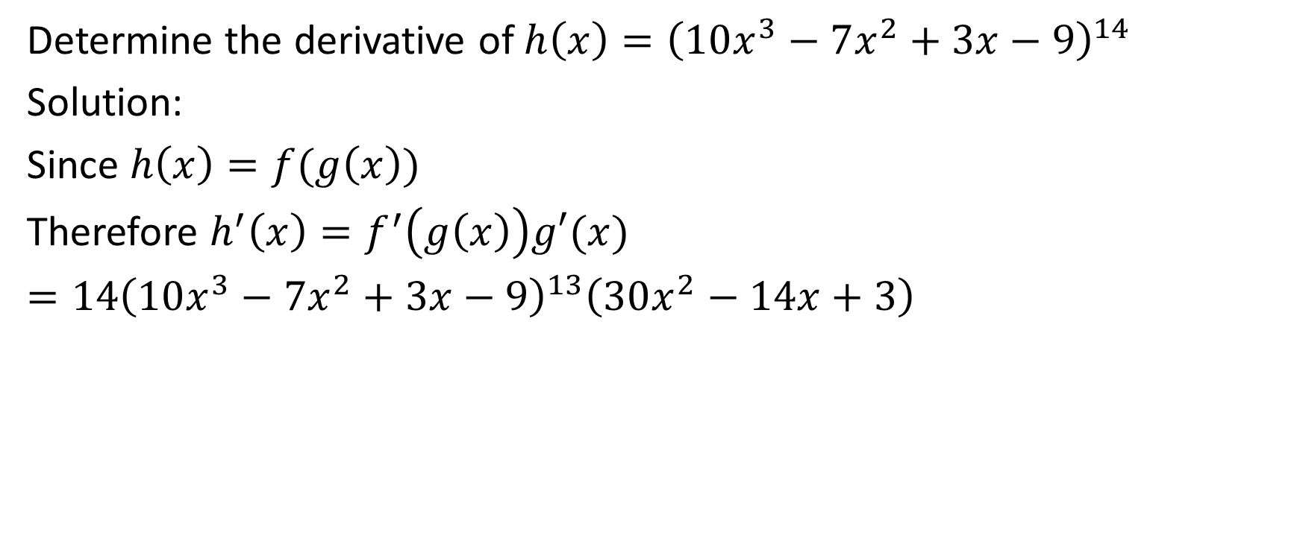
Determine the derivative of $h\left(x\right)={\left(10x^{3}−7x^{2}+3x−9\right)}^{14}$
Solution:
Since $h\left(x\right)=f(g\left(x\right))$
Therefore $h^{′}\left(x\right)=f^{′}\left(g\left(x\right)\right)g′(x)$
$=14{\left(10x^{3}−7x^{2}+3x−9\right)}^{13}\left(30x^{2}−14x+3\right)$

Slide 18
Determine the derivative of $h\left(x\right)={\left(10x^{3}−7x^{2}+3x−9\right)}^{14}$
Solution:
Since $h\left(x\right)=f(g\left(x\right))$
Therefore $h^{′}\left(x\right)=f^{′}\left(g\left(x\right)\right)g′(x)$
$=14{\left(10x^{3}−7x^{2}+3x−9\right)}^{13}\left(30x^{2}−14x+3\right)$
It’s not necessary to state the inner and outer functions each time you do a chain rule question.

Slide 19

Example
Determine the derivative of $y={\left(x^{2}+x\right)}^{\frac{3}{2}}$

Slide 20

Determine the derivative of $y={\left(x^{2}+x\right)}^{\frac{3}{2}}$
Solution:
$y^{′}=\frac{3}{2}{\left(x^{2}+x\right)}^{\frac{1}{2}}\left(2x+1\right)$

Slide 21

Example
If $y=2u^{4}−3u^{2}+u−1$ and if $u=4\sqrt{x}$, then determine the value of $\frac{dy}{dx}$ at $x=1$.

Slide 22
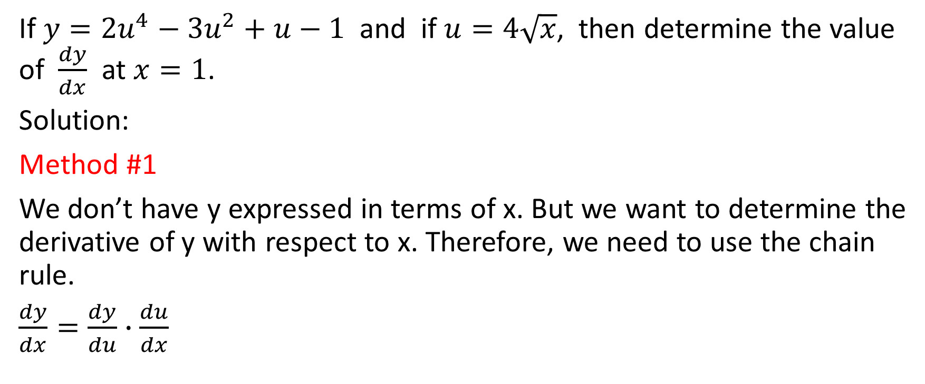
If $y=2u^{4}−3u^{2}+u−1$ and if $u=4\sqrt{x}$, then determine the value of $\frac{dy}{dx}$ at $x=1$.
Solution:
Method #1
We don’t have y expressed in terms of x. But we want to determine the derivative of y with respect to x. Therefore, we need to use the chain rule.
$\frac{dy}{dx}=\frac{dy}{du}∙\frac{du}{dx}$

Slide 23
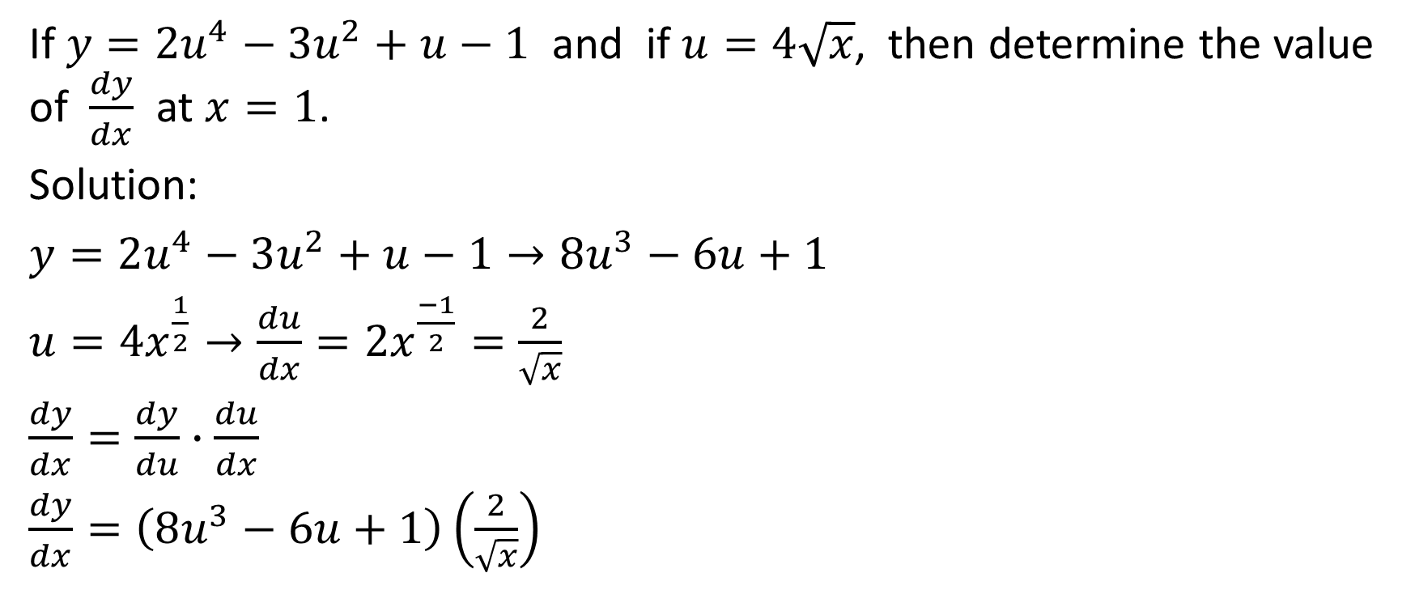
If $y=2u^{4}−3u^{2}+u−1$ and if $u=4\sqrt{x}$, then determine the value of $\frac{dy}{dx}$ at $x=1$.
Solution:
$y=2u^{4}−3u^{2}+u−1→8u^{3}−6u+1$
$u=4x^{\frac{1}{2}}→\frac{du}{dx}=2x^{\frac{−1}{2}}=\frac{2}{\sqrt{x}}$
$\frac{dy}{dx}=\frac{dy}{du}∙\frac{du}{dx}$
$\frac{dy}{dx}=\left(8u^{3}−6u+1\right)\left(\frac{2}{\sqrt{x}}\right)$

Slide 24
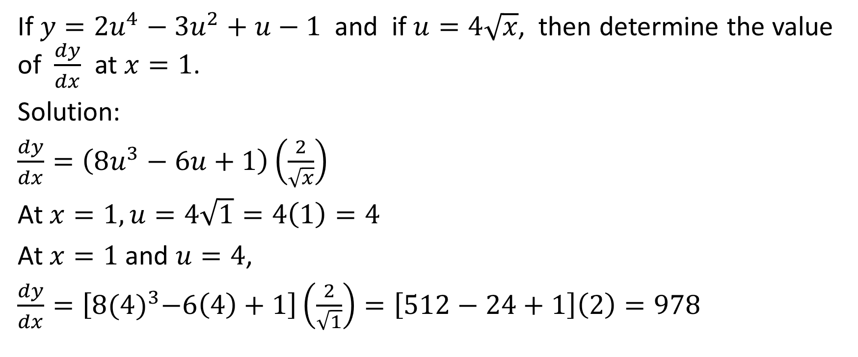
If $y=2u^{4}−3u^{2}+u−1$ and if $u=4\sqrt{x}$, then determine the value of $\frac{dy}{dx}$ at $x=1$.
Solution:
$\frac{dy}{dx}=\left(8u^{3}−6u+1\right)\left(\frac{2}{\sqrt{x}}\right)$
At $x=1, u=4\sqrt{1}=4\left(1\right)=4$
At $x=1$ and $u=4$,
$\frac{dy}{dx}=\left[8{(4)}^{3}−6\left(4\right)+1\right]\left(\frac{2}{\sqrt{1}}\right)=\left[512−24+1\right]\left(2\right)=978$

Slide 25
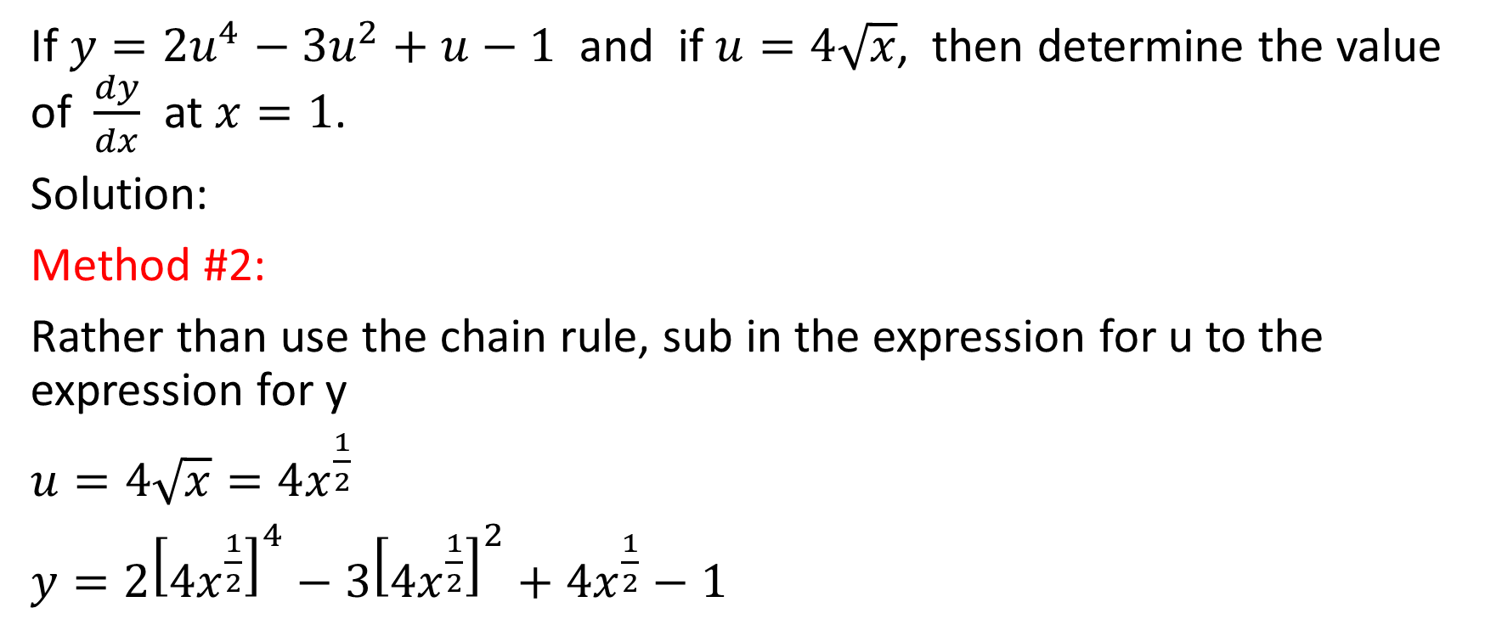
If $y=2u^{4}−3u^{2}+u−1$ and if $u=4\sqrt{x}$, then determine the value of $\frac{dy}{dx}$ at $x=1$.
Solution:
Method #2:
Rather than use the chain rule, sub in the expression for u to the expression for y
$u=4\sqrt{x}=4x^{\frac{1}{2}}$
$y=2{\left[4x^{\frac{1}{2}}\right]}^{4}−3{\left[4x^{\frac{1}{2}}\right]}^{2}+4x^{\frac{1}{2}}−1$

Slide 26
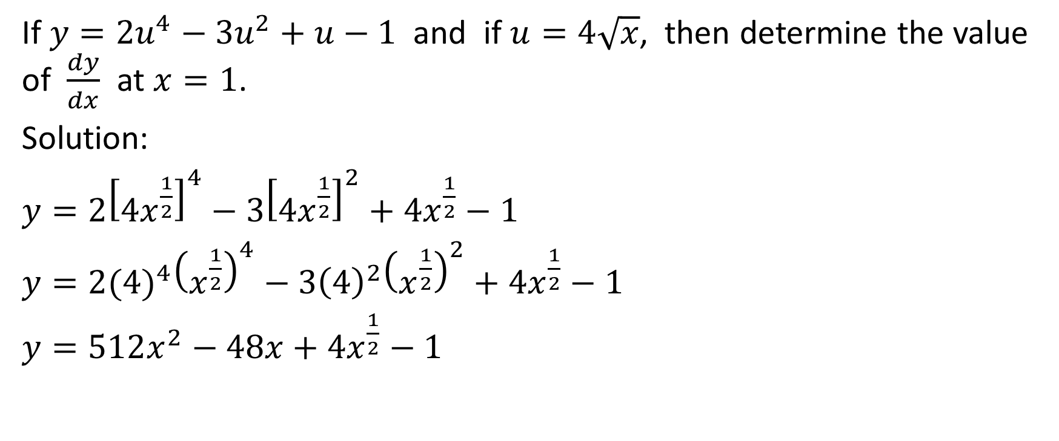
If $y=2u^{4}−3u^{2}+u−1$ and if $u=4\sqrt{x}$, then determine the value of $\frac{dy}{dx}$ at $x=1$.
Solution:
$y=2{\left[4x^{\frac{1}{2}}\right]}^{4}−3{\left[4x^{\frac{1}{2}}\right]}^{2}+4x^{\frac{1}{2}}−1$
$y=2{(4)}^{4}{\left(x^{\frac{1}{2}}\right)}^{4}−3{\left(4\right)}^{2}{\left(x^{\frac{1}{2}}\right)}^{2}+4x^{\frac{1}{2}}−1$
$y=512x^{2}−48x+4x^{\frac{1}{2}}−1$

Slide 27
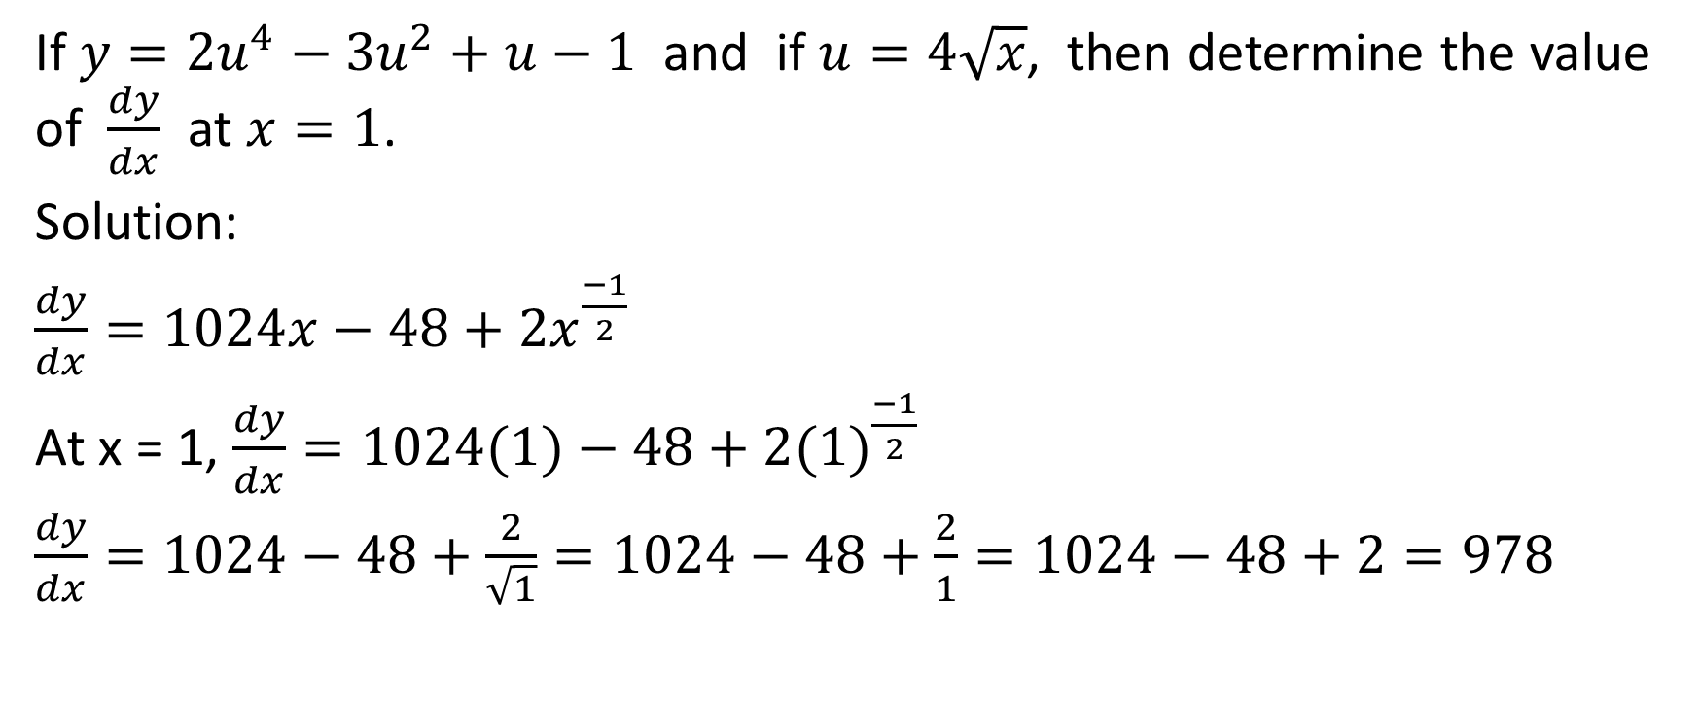
If $y=2u^{4}−3u^{2}+u−1$ and if $u=4\sqrt{x}$, then determine the value of $\frac{dy}{dx}$ at $x=1$.
Solution:
$\frac{dy}{dx}=1024x−48+2x^{\frac{−1}{2}}$
At x = 1, $\frac{dy}{dx}=1024(1)−48+2{(1)}^{\frac{−1}{2}}$
$\frac{dy}{dx}=1024−48+\frac{2}{\sqrt{1}}=1024−48+\frac{2}{1}=1024−48+2=978$

Slide 28

Example
Suppose $f\left(12\right)=−7, g\left(3\right)=12, f^{′}\left(12\right)=11$ and $g^{′}\left(3\right)=9$. If $h\left(x\right)=f(g\left(x\right))$, then evaluate $h′(3)$.

Slide 29
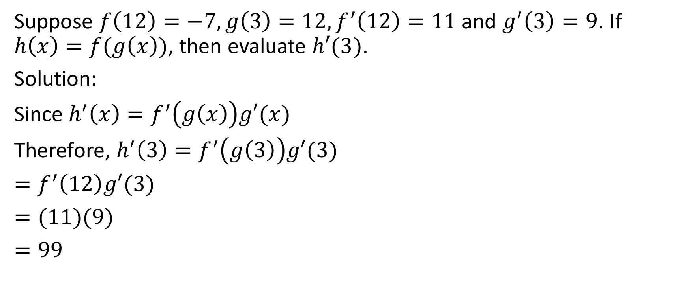
Suppose $f\left(12\right)=−7, g\left(3\right)=12,f^{′}\left(12\right)=11$ and $g^{′}\left(3\right)=9$. If $h\left(x\right)=f(g\left(x\right))$, then evaluate $h′(3)$.
Solution:
Since $h^{′}\left(x\right)=f^{′}\left(g\left(x\right)\right)g′(x)$
Therefore, $h^{′}\left(3\right)=f^{′}\left(g\left(3\right)\right)g′(3)$
$=f^{′}\left(12\right)g′(3)$
$=(11)(9)$
$=99$

Slide 30

Example
Evaluate $k′(−1)$ where $k\left(x\right)={\left(\frac{x^{3}−3}{x^{3}+3}\right)}^{8}$

Slide 31
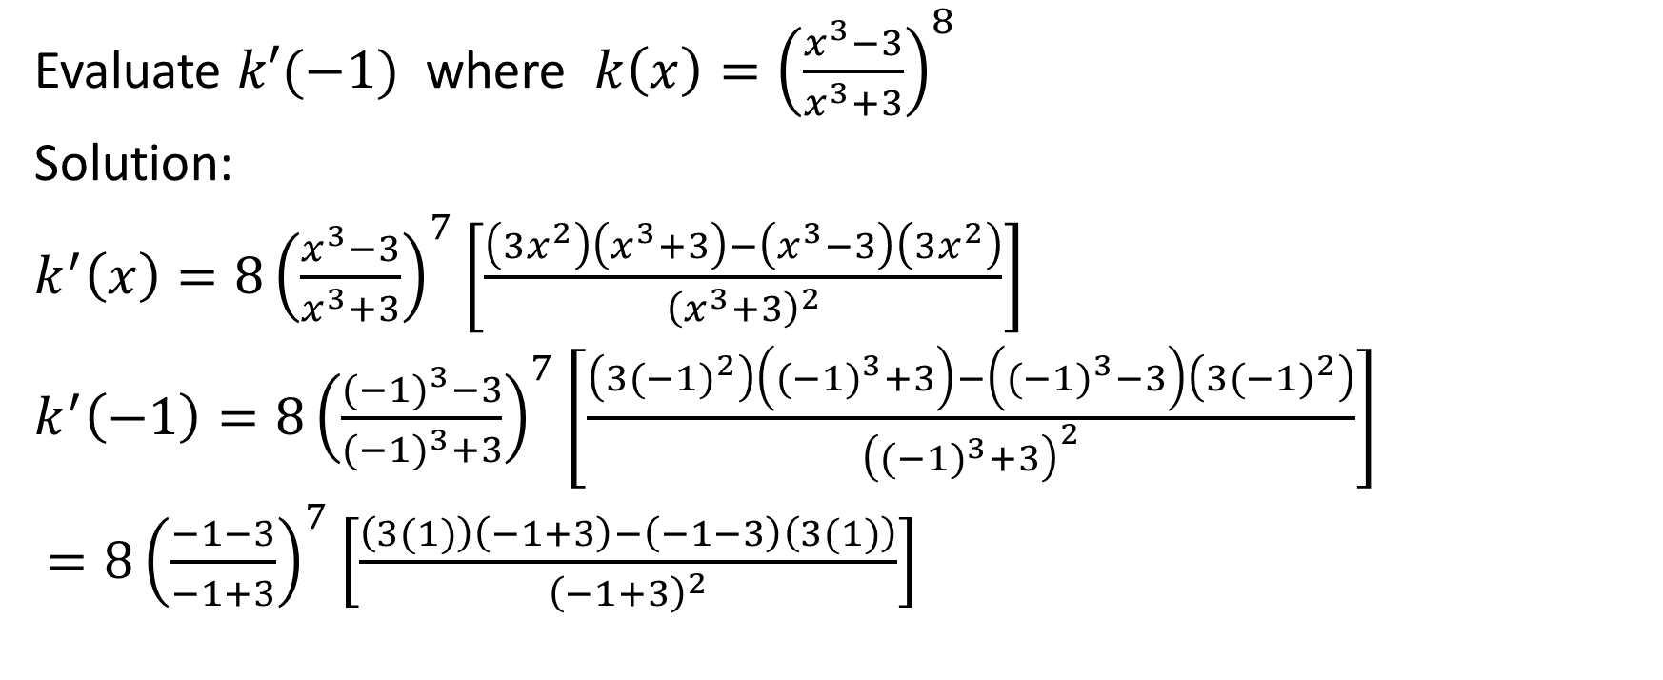
Evaluate $k′(−1)$ where $k\left(x\right)={\left(\frac{x^{3}−3}{x^{3}+3}\right)}^{8}$
Solution:
$k^{′}\left(x\right)=8{\left(\frac{x^{3}−3}{x^{3}+3}\right)}^{7}\left[\frac{\left(3x^{2}\right)\left(x^{3}+3\right)−\left(x^{3}−3\right)\left(3x^{2}\right)}{{\left(x^{3}+3\right)}^{2}}\right]$
$k^{′}\left(−1\right)=8{\left(\frac{{(−1)}^{3}−3}{{(−1)}^{3}+3}\right)}^{7}\left[\frac{\left(3{(−1)}^{2}\right)\left({(−1)}^{3}+3\right)−\left({(−1)}^{3}−3\right)\left(3{(−1)}^{2}\right)}{{\left({(−1)}^{3}+3\right)}^{2}}\right]$
$=8{\left(\frac{−1−3}{−1+3}\right)}^{7}\left[\frac{\left(3(1)\right)\left(−1+3\right)−\left(−1−3\right)\left(3(1)\right)}{{\left(−1+3\right)}^{2}}\right]$

Slide 32
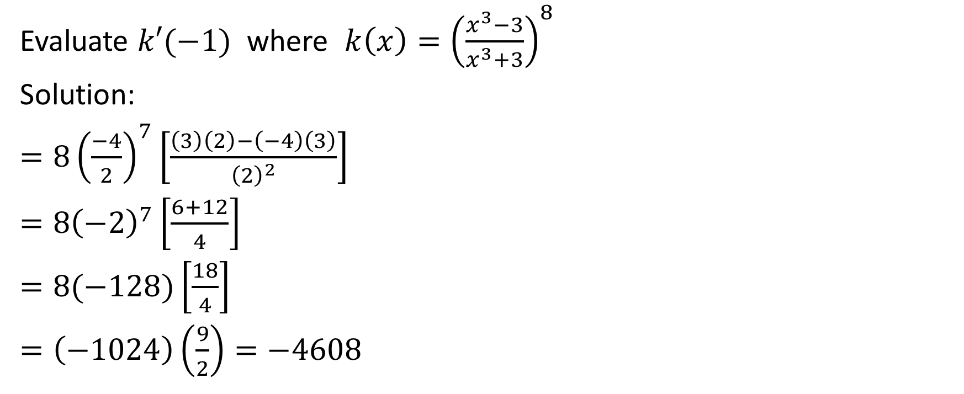
Evaluate $k′(−1)$ where $k\left(x\right)={\left(\frac{x^{3}−3}{x^{3}+3}\right)}^{8}$
Solution:
$=8{\left(\frac{−4}{2}\right)}^{7}\left[\frac{\left(3\right)\left(2\right)−\left(−4\right)\left(3\right)}{{\left(2\right)}^{2}}\right]$
$=8{\left(−2\right)}^{7}\left[\frac{6+12}{4}\right]$
$=8(−128)\left[\frac{18}{4}\right]$
$=\left(−1024\right)\left(\frac{9}{2}\right)=−4608$

